Slide 1
SAFE USE OF FENTANYL OROMUCOSAL FORMULATIONS FOR BREAKTHROUGH CANCER PAIN
HIGH RISK MEDICINES
EDUCATION
Education delivered by:
Date of education:
© 2020 NSW Therapeutic Advisory Group Inc and State of NSW (NSW Health). Contact nswtag@stvincents.com.au

Slide 2
Objectives
Provide a brief overview of fentanyl oromucosal formulations currently available.
Describe recognised safety issues with:
Prescribing for specific patients
Dosing
Administration
Storage, handling, recording and disposal.
Discuss strategies to address safety issues.

Slide 3
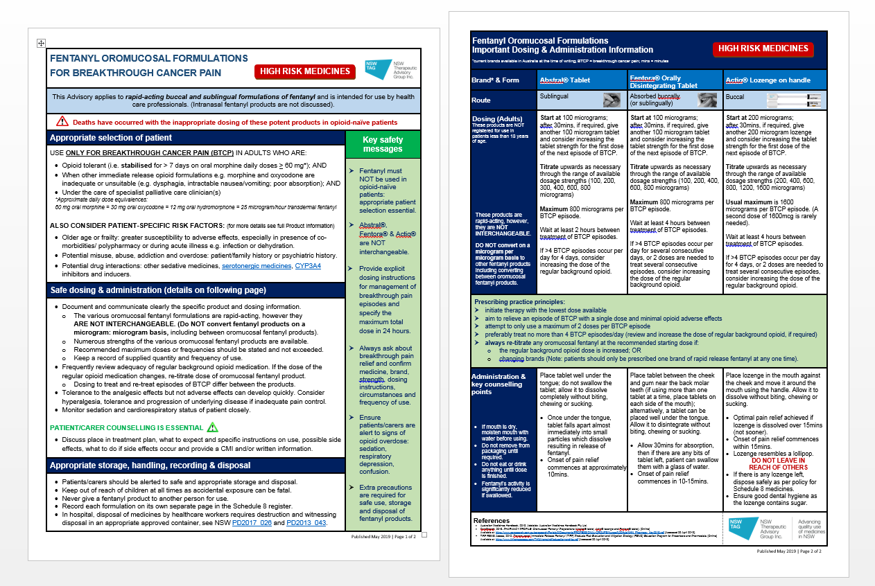
Advisory

Slide 4
Oromucosal fentanyl formulations
This presentation and the accompanying Advisory applies to rapid-acting buccal and sublingual formulations of fentanyl and is intended for use by health care professionals.
Intranasal fentanyl products are not discussed.

Slide 5
Fentanyl
potent opioid analgesic with rapid onset of analgesia and short duration of action
≈100-fold more potent analgesic than morphine
numerous formulations available
injection, patch, tablet, lozenge, nasal solution
numerous strengths and brands
numerous safety incidents

Slide 6
Oromucosal fentanyl formulations
Three rapid acting# oromucosal FENTANYL formulations* registered in Australia and on PBS
Abstral® sublingual tablet
Fentora® orally disintegrating tablet (ODT)
Actiq® buccal lozenge on a stick.
Indicated solely for Breakthrough Cancer Pain (BTCP) in opioid tolerant patients.
Clinically important differences in their rate and extent of absorption
Are not equivalent on a microgram: microgram basis
with each other or with any other fentanyl products
incorrect substitution or switching of a fentanyl product for another product may result in fatal overdose.
# Another rapid acting fentanyl formulation is the intranasal solution, available in some hospitals only; not on PBS.
* Called Transmucosal Immediate Release Fentanyl (TIRF) medicines in the US

Slide 7
Oromucosal fentanyl formulations
Deaths have occurred with
inappropriate dosing of these potent products in opioid-naïve patients
Notes:
Fatal respiratory depression and death has occurred in patients treated with rapid acting oromucosal fentanyl formulations, including following use in opioid naïve patients and improper dosing.

Slide 8
Appropriate patient selection
USE ONLY FOR BTCP IN ADULTS WHO ARE:
Opioid tolerant (i.e. stabilised for > 7 days on oral morphine daily doses > 60 mg*);
*Approximate daily dose equivalences: 60 mg oral morphine = 30 mg oral oxycodone = 12 mg oral hydromorphone = 25 microgram/hour transdermal fentanyl
AND
When other immediate release opioid formulations e.g. morphine and oxycodone are inadequate or unsuitable (e.g. dysphagia, intractable nausea/vomiting; poor absorption);
AND
Under the care of specialist palliative care clinician(s)
ALSO CONSIDER PATIENT-SPECIFIC RISK FACTORS including
Older age or frailty: greater susceptibility to adverse effects, especially in presence of co-morbidities/ polypharmacy or during acute illness e.g. infection or dehydration.
Potential misuse, abuse, addiction and overdose: patient/family history or psychiatric history.
Potential drug interactions: other sedative medicines, serotonergic medicines,
CYP3A4 inhibitors and inducers.
Notes:
*Approximate daily dose equivalences may vary depending on the reference text used.

Slide 9
Prescribing practice principles
Initiate therapy with the lowest dose available.
Aim to relieve an episode of BTCP with a single dose and minimal opioid adverse effects.
Attempt to only use a maximum of 2 doses per BTCP episode.
Preferably treat no more than 4 BTCP episodes/day (review and increase the dose of regular background opioid, if required).
Always re-titrate any oromucosal fentanyl at the recommended starting dose if:
the regular background opioid dose is increased; OR
changing brands (Note: patients should only be prescribed one brand of rapid release fentanyl at any one time).

Slide 10
Safe dosing & administration
NOT registered for use in patients less than 18 years of age
The various oromucosal fentanyl formulations are rapid-acting, however they
ARE NOT INTERCHANGEABLE
Document and communicate clearly the specific product and dosing information
Numerous strengths available
State and do not exceed recommended maximum doses or frequencies
Keep a record of supplied quantity and frequency of use.
Frequently review adequacy of regular background opioid medication.
Re-titrate dose of oromucosal fentanyl product if regular opioid dose changes
Dosing to treat and re-treat episodes of BTCP differs between the products.
Tolerance to the analgesic effects but not adverse effects can develop quickly.
Consider hyperalgesia, tolerance and progression of underlying disease if inadequate pain control.
Closely monitor sedation and cardiorespiratory status.

Slide 11
Administration & key counselling points
If mouth is dry, moisten mouth with water before using
Do not remove from packaging until required
Do not eat or drink anything until dose is finished
Fentanyl’s activity is significantly reduced if swallowed
PATIENT/CARER COUNSELLING IS ESSENTIAL
Discuss place in treatment plan, what to expect and specific instructions on use, possible side effects, what to do if side effects occur and provide a CMI and/or written information.

Slide 12
Appropriate storage, handling, recording & disposal
Patients/carers should be alerted to safe and appropriate storage and disposal.
Keep out of reach of children at all times as accidental exposure can be fatal.
Never give a fentanyl product to another person to use.
Record each formulation on its own separate page in the Schedule 8 register.
In hospital, disposal of medicines by healthcare workers requires destruction and witnessing disposal in an appropriate approved container, see NSW PD2017_026 and PD2013_043.

Slide 13
Key safety messages
Do NOT use in opioid-naïve patients: appropriate patient selection essential
Abstral®, Fentora® & Actiq® are NOT interchangeable.
Provide explicit dosing instructions for management of breakthrough pain episodes and specify the maximum total dose in 24 hours.
Always ask about breakthrough pain relief and confirm medicine, brand, strength, dosing instructions, circumstances and frequency of use.
Ensure patients/carers are alert to signs of opioid overdose: sedation, respiratory depression, confusion.
Extra precautions required for safe use, storage and disposal.

Slide 14
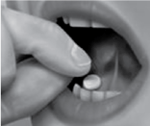
Abstral® Tablet
Brand & Form | Abstral® Tablet |  | Place tablet well under the tongue; do not swallow the tablet; allow it to dissolve completely without biting, chewing or sucking. Once under the tongue, tablet falls apart almost immediately into small particles which dissolve resulting in release of fentanyl. Onset of pain relief commences at approximately 10mins.
Route | Sublingual
Dosing (Adults) These products are NOT registered for use in patients less than 18 years of age. These products are rapid-acting, however, they are NOT INTERCHANGEABLE. DO NOT convert on a microgram per microgram basis to other fentanyl products including converting between oromucosal fentanyl products. | Start at 100 micrograms; after 30mins, if required, give another 100 microgram tablet and consider increasing the tablet strength for the first dose of the next episode of BTCP. Titrate upwards as necessary through the range of available dosage strengths (100, 200, 300, 400, 600, 800 micrograms) Maximum 800 micrograms per BTCP episode. Wait at least 2 hours between treatment of BTCP episodes. If >4 BTCP episodes occur per day for 4 days, consider increasing the dose of the regular background opioid. | Administration & key counselling points

Slide 15
Fentora® Orally Disintegrating Tablet
Brand & Form | Fentora® Orally Disintegrating Tablet |  | Place tablet between the cheek and gum near the back molar teeth (if using more than one tablet at a time, place tablets on each side of the mouth); alternatively, a tablet can be placed well under the tongue. Allow it to disintegrate without biting, chewing or sucking. Allow 30mins for absorption, then if there are any bits of tablet left, patient can swallow them with a glass of water. Onset of pain relief commences in 10-15mins.
Route | Absorbed buccally (or sublingually)
Dosing (Adults) These products are NOT registered for use in patients less than 18 years of age. These products are rapid-acting, however, they are NOT INTERCHANGEABLE. DO NOT convert on a microgram per microgram basis to other fentanyl products including converting between oromucosal fentanyl products. | Start at 100 micrograms; after 30mins, if required, give another 100 microgram tablet and consider increasing the tablet strength for the first dose of the next episode of BTCP. Titrate upwards as necessary through the range of available dosage strengths (100, 200, 400, 600, 800 micrograms) Maximum 800 micrograms per BTCP episode. Wait at least 4 hours between treatment of BTCP episodes. If >4 BTCP episodes occur per day for several consecutive days, or 2 doses are needed to treat several consecutive episodes, consider increasing the dose of the regular background opioid. | Administration & key counselling points

Slide 16
Actiq® Lozenge on handle
Brand & Form | Actiq® Lozenge on handle |  | Place lozenge in the mouth against the cheek and move it around the mouth using the handle. Allow it to dissolve without biting, chewing or sucking. Optimal pain relief achieved if lozenge is dissolved over 15mins (not sooner). Onset of pain relief commences within 15mins. Lozenge resembles a lollipop. DO NOT LEAVE IN REACH OF OTHERS If there is any lozenge left, dispose safely as per policy for Schedule 8 medicines. Ensure good dental hygiene as the lozenge contains sugar.
Route | Buccal
Dosing (Adults) These products are NOT registered for use in patients less than 18 years of age. These products are rapid-acting, however, they are NOT INTERCHANGEABLE. DO NOT convert on a microgram per microgram basis to other fentanyl products including converting between oromucosal fentanyl products. | Start at 200 micrograms; after 30mins, if required, give another 200 microgram lozenge and consider increasing the tablet strength for the first dose of the next episode of BTCP. Titrate upwards as necessary through the range of available dosage strengths (200, 400, 600, 800, 1200, 1600 micrograms) Usual maximum is 1600 micrograms per BTCP episode. (A second dose of 1600mcg is rarely needed). Wait at least 4 hours between treatment of BTCP episodes. If >4 BTCP episodes occur per day for 4 days, or 2 doses are needed to treat several consecutive episodes, consider increasing the dose of the regular background opioid. | Administration & key counselling points

Slide 17
Quiz Question 1
1. For which patients may an oromucosal fentanyl formulation be indicated? (More than one answer is correct)
Patient 1: 17 year old male who has stable opioid analgesic requirements
Patient 2: 67 year old female who has intractable nausea and vomiting for the last 3 days and has break through cancer pain (BTCP)
Patient 3: 53 year old male who has dysphagia and is experiencing BTCP
Patient 4: 60 year old male who has swallowing difficulties and acute pain
Notes:
Answers:
a. Patient 2: 67 year old female who has intractable nausea and vomiting for the last 3 days and has break through cancer pain (BTCP)
b. Patient 3: 53 year old male who has dysphagia and is experiencing BTCP

Slide 18
Quiz Question 1 - Answers
1. For which patients may an oromucosal fentanyl formulation be indicated? (More than one answer is correct)
Patient 2: 67 year old female who has intractable nausea and vomiting for the last 3 days and has break through cancer pain (BTCP)
b. Patient 3: 53 year old male who has dysphagia and is experiencing BTCP
Notes:
Answers:
a. Patient 2: 67 year old female who has intractable nausea and vomiting for the last 3 days and has break through cancer pain (BTCP)
b. Patient 3: 53 year old male who has dysphagia and is experiencing BTCP

Slide 19
Quiz Question 2
2. Which order regarding onset of pain relief, from fastest to slowest, is most correct for the different oromucosal fentanyl formulations?
Abstral > Actiq > Fentora
Abstral > Fentora > Actiq
Fentora > Actiq > Abstral
Actiq > Abstral > Fentora
Notes:
Answer:
a. Abstral > Fentora > Actiq

Slide 20
Quiz Question 2 - Answer
2. Which order regarding onset of pain relief, from fastest to slowest, is most correct for the different oromucosal fentanyl formulations?
Abstral > Actiq > Fentora
Notes:
Answer:
a. Abstral > Fentora > Actiq

Slide 21
Quiz Question 3
3. Ms RL, a 58 year old female has been prescribed Fentora® for breakthrough cancer pain. It is currently being administered buccally. There appears to be no more stock in the DD safe and the junior medical officer has prescribed Actiq® instead. What is the likely rationale for this substitution and why may Actiq® be inappropriate for the patient?
Notes:
Answer on next slide

Slide 22
Quiz Question 3 - Answer
Possible rationale; They can both be administered buccally and both have similar dosing frequencies for BTCP when administered buccally (should be at least 4 hours for treatment of BTCP episodes).
However,
It is not recommended to use more than one brand of oromucosal fentanyl products, brands ARE NOT interchangeable.
Recommend sourcing the same brand from elsewhere before switching the patient to another brand.
In the rare circumstance that the Fentora® brand (in the correct strength) is not obtainable but Actiq® is, the commencing dose of Actiq® would need to be the recommended starting dose (200 micrograms) whether Ms RL was on the lowest dose of Fentora® (100 micrograms) or not. The dose could then be titrated as required thereafter. Note it is not recommended that any of the oromucosal fentanyl products be crushed or split. In order to reduce medication errors, it should also be noted that hospital wards would normally only routinely stock one brand of oromucosal fentanyl products. Reference to local or state policy is advised.
It is recommended that the JMO or other relevant clinician seeks advice from a palliative care physician regarding management of BTCP in Ms RL if Fentora® at the correct strength is not available.
Notes:
- Possible rationale; They can both be administered buccally and both have similar dosing frequencies for BTCP when administered buccally (should be at least 4 hours for treatment of BTCP episodes)
BUT
- It is not recommended to use more than one brand of oromucosal fentanyl products as the brands ARE NOT interchangeable.
- Recommend sourcing the same brand from elsewhere before switching the patient to another brand.
- In the rare circumstance that the Fentora® brand (in the correct strength) is not obtainable but Actiq® is, the commencing dose of Actiq® would need to be the recommended starting dose (200 micrograms) whether Ms RL was on the lowest dose of Fentora® (100 micrograms) or not. The dose could then be titrated as required thereafter. Note it is not recommended that any of the oromucosal fentanyl products be crushed or split. In order to reduce medication errors, it should also be noted that hospital wards would normally only routinely stock one brand of oromucosal fentanyl products. Reference to local or state policy is advised.
- It is recommended that the JMO or other relevant clinician seeks advice from a palliative care physician regarding management of BTCP in Ms RL if Fentora® at the correct strength is not available.

Slide 23
Quiz Question 4
4. Mr VP who has been on opioid therapy for some time for cancer pain, has been prescribed 200 microgram of Actiq® in hospital for his BTCP. This was last administered to Mr VP this morning and he has since complained of feeling very drowsy. After looking at the drug safe, Abstral® 200 microgram was inadvertently placed where Actiq® 200 microgram was meant to be. Why is this an immediate concern?
Notes:
Answer:
- Brands are not interchangeable and not equivalent on a microgram: microgram basis with each other.
- Mr VP is likely suffering from opioid toxicity.
- Call for the doctor immediately.

Slide 24
Quiz Question 4 - Answer
Brands are not interchangeable and are not equivalent on a microgram: microgram basis with each other.
Mr VP is likely suffering from opioid toxicity.
Call for the doctor immediately.
 | Abstral® | Fentora® | Actiq®
Route | Sublingual | Sublingual/ Buccal | Buccal
Recommendations | Wait at least 2 hours between treatment of BTCP episodes | Wait at least 4 hours between treatment of BTCP episodes | Wait at least 4 hours between treatment of BTCP episodes
Onset of pain relief | Approx. 10 minutes | 10-15 minutes | 15 minutes, no sooner
Max per BTCP episode | 800 mcg | 800 mcg | Usually 1600 mcg
Notes:
Answer:
- Brands are not interchangeable and not equivalent on a microgram: microgram basis with each other.
- Mr VP is likely suffering from opioid toxicity.
- Call for the doctor immediately.

Slide 25
References
Australian Medicines Handbook, 2020. Adelaide: Australian Medicines Handbook Pty Ltd.
CareSearch, 2016. PHARMACY PROFILE: Oromucosal Fentanyl Preparations (Abstral® tablet, Actiq® lozenge and Fentora® tablet). [Online] Available at: https://www.caresearch.com.au/caresearch/Portals/0/Documents/PROFESSIONAL-GROUPS/Nurses%20Hub/NHN_Pharmacy_Nov2016.pdf [Accessed 29 April 2019].
TIRF REMS Access, 2012. Transmucosal Immediate Release Fentanyl (TIRF) Products Risk Evaluation and Mitigation Strategy (REMS) Education Program for Prescribers and Pharmacists. [Online] Available at: https://www.tirfremsaccess.com/TirfUI/rems/pdf/education-and-ka.pdf [Accessed 29 April 2019].

Slide 26
Contact details:
<< Hospital name >>
Ph: << 0000 0000 pager XXXX >>
Email: <<add email address>>

