Slide 1
SAFE USE OF OPIOID SKIN PATCHES
HIGH RISK MEDICINES
EDUCATION
Education delivered by:
Date of education:

Slide 2
Objectives
Provide a brief overview of opioid skin patches currently available.
Describe recognised safety issues
Prescribing for specific patients
Dosing
Administration
Storage, handling, recording and disposal.
Discuss strategies to address safety issues.

Slide 3
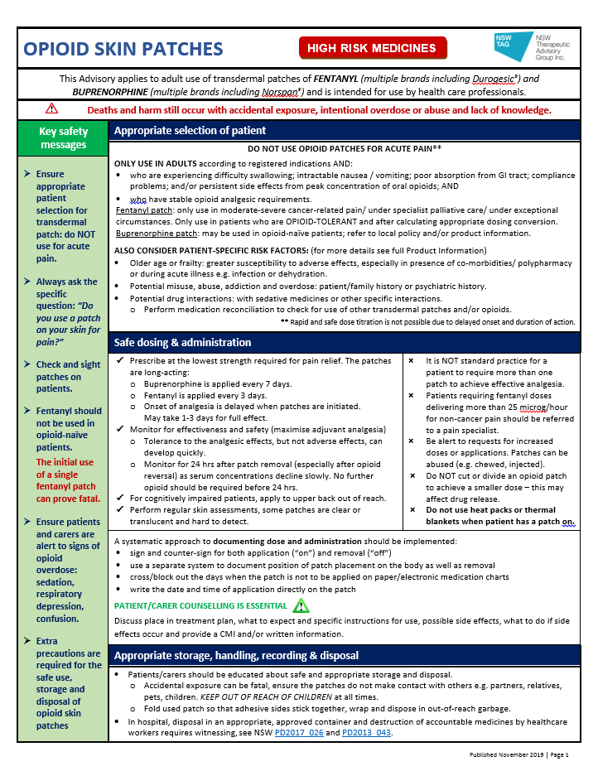
Opioid Skin Patches Advisory
Notes:
Insert screenshot of advisory on patches once finalised

Slide 4
Opioid skin patches
This presentation and the accompanying Advisory applies to ADULT use of transdermal patches of
fentanyl and buprenorphine
and is intended for use by health care professionals.
Deaths from these products still occur with accidental exposure, intentional overdose and lack of knowledge.

Slide 5
Opioid patches
*DO NOT USE FOR ACUTE PAIN*
Patches have a delayed onset and duration of action: rapid and safe dose titration not possible
Important differences in dose equivalence
oral morphine 50 mg/day ≈ fentanyl patch 12 microg/hr
oral morphine 50 mg/day ≈ buprenorphine patch 20 microg/hr
Numerous brands of opioid transdermal patches on PBS
fentanyl: Denpax®, Durogesic®, Dutran®, Fenpatch®, APO-Fentanyl®, Fentanyl Sandoz®
buprenorphine: Bupredermal®, Buprenorphine Sandoz ® and Norspan®
Notes:
Dose equivalence are approximate values only.

Slide 6
Fentanyl patch
potent opioid analgesic with
delayed onset of analgesia (1-3 days) and
long duration of action (3 days).
≈ 100-fold more potent than morphine
numerous strengths
12 microg/hr, 25 microg/hr, 50 microg/hr, 75 microg/hr and 100 microg/hr
numerous safety incidents including fatalities
RESTRICTED indications: moderate-severe cancer pain/ patients in palliative care under specialist/ exceptional circumstances
must NOT be used in opioid-naïve patients
Notes:
Should only be used in opioid tolerant patients (i.e. stabilised for > 7 days on oral morphine daily doses > 60 mg*);
*Approximate oral Morphine Equivalent Daily Dose (oMEDD) (may vary depending on reference text consulted): 60 mg oral morphine = 40 mg oral oxycodone = 12 mg oral hydromorphone = 25 microgram/hour transdermal fentanyl

Slide 7
Buprenorphine patch
potent opioid analgesic with:
delayed onset of analgesia (2-3 days) and
long duration of action (7 days).
≈ 75-fold more potent than morphine
numerous strengths:
5 microg/hour, 10microg/hr, 15 microg/hr, 20 microg/hr,
25 microg/hr, 30 microg/hr, 40 microg/hr
numerous safety incidents

Slide 8
Opioid patches
Serious harm can occur with INAPPROPRIATE
- patient selection
dosing and administration
disposal
Notes:
Fatal respiratory depression and death has occurred in patients treated with rapid acting oromucosal fentanyl formulations, including following use in opioid naïve patients and improper dosing.

Slide 9
Appropriate patient selection
Only use in adults with moderate-severe pain
in accordance with registered indications/restrictions;
experiencing swallowing difficulties, intractable nausea/vomiting, poor absorption from GI tract, compliance problems and/or persistent side effects from peak concentrations of oral opioids;
AND
have stable opioid analgesic requirements AND
Notes:
fentanyl patches only for patients who are already tolerant to opioid therapy of comparable potency
buprenorphine may be suitable for opioid-naïve patients – refer to local hospital restrictions and/or product information

Slide 10
Also consider the following risk factors
Older age or frailty:
↑ susceptibility to adverse effects, especially in presence of co-morbidities/ polypharmacy or during acute illness e.g. infection or dehydration
Potential misuse, abuse, addiction and overdose: patient/family history or psychiatric history
Potential drug interactions
other sedative medicines, serotonergic medicines (fentanyl), CYP3A4 inhibitors and inducers (fentanyl)
Perform medication reconciliation to check for use of transdermal patches and/or other opioids

Slide 11
Prescribing practice principles
Prescribe at the lowest strength required for pain relief
Patches are long acting:
- fentanyl is applied every 3 days - buprenorphine is applied every 7 days
It is NOT standard for a patient to require > 1 patch to achieve effective analgesia
Monitor for effectiveness and safety (maximise other analgesia where possible)
NB: once a patch is removed and not replaced, a reservoir remains and appropriate monitoring should continue for 24 hours after removal
Tolerance to the analgesic effects, but not adverse effects, develops quickly. Consider hyperalgesia, tolerance and progression of underlying disease if inadequate pain control.
Do NOT cut an opioid patch to achieve a smaller dose–affects drug release

Slide 12
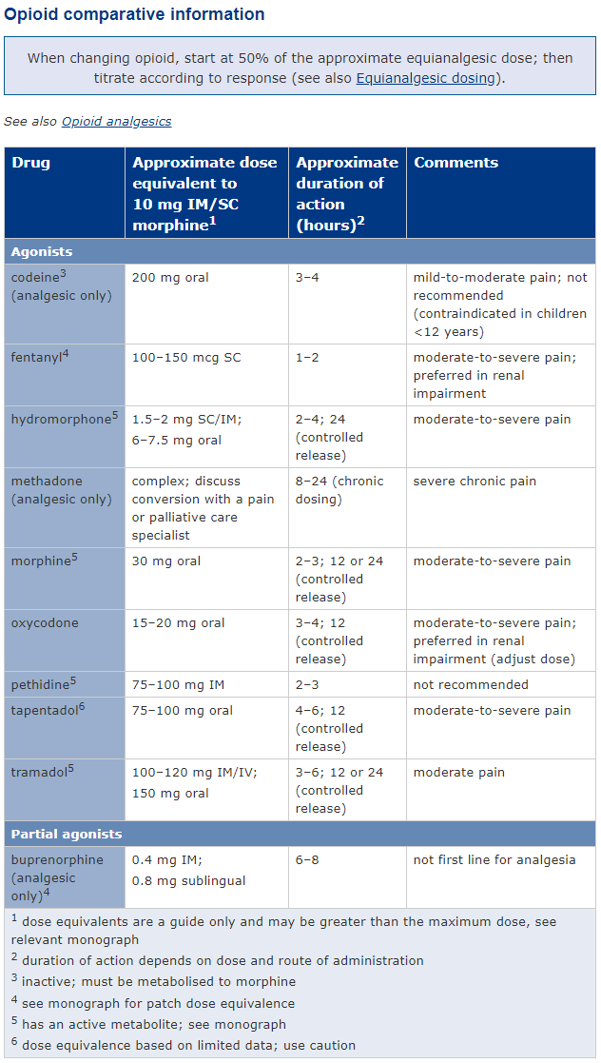
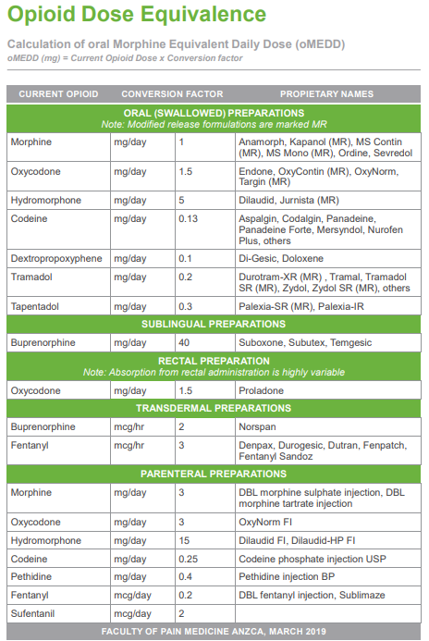
Prescribing practice principles
In general for all opioids, caution is required if any opioid dose equivalence tables are used to guide dosing for opioid switching, as the administration of a calculated ‘equivalent’ dose of the replacement opioid may lead to overdosage.
It should be noted that there is considerable variability in pharmacokinetics and pharmacodynamics of the different opioids, within and between individual patients. In addition, interactions with non-opioid drugs can strongly influence opioid pharmacokinetics.
It is also recommended that when changing from one opioid to another, commence with 50% to 75% of the calculated equianalgesic dose and then titrate to response.

Slide 13
Prescribing practice principles
An opioid equianalgesic calculator developed by the Faculty of Pain Medicine, Australian and New Zealand College of Anaesthetists (FPM ANZCA) provides a clinical tool simplifying the calculation of equianalgesia expressed as total oral morphine equivalent daily dose (oMEDD), and it also provides four options for dose reductions. This calculator is available via web browser or as a smart phone application.

Slide 14
Safe dosing & administration
Remove old patch before applying new one
NB: some patches are clear which makes them hard to detect;
May have fallen off: check bed linen, clothes, floor
Implement a systematic approach to documenting dose and administration
sign and counter-sign for both application (“on”) and removal (“off”)
use a separate system to document position of placement of patch and removal
cross out the days when the patch is not to be applied on medication charts
the date and time of application should be written on the patch
Perform regular skin assessments to ensure patch has correct adhesion
Monitor sedation and cardiorespiratory status

Slide 15
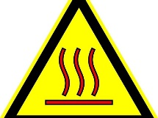
Administration & key counselling points
DO NOT EXPOSE patch application site to heat sources: hot baths, heat packs or thermal blankets
Write the date & time of application on the patch with permanent marker
For cognitively impaired patients
Apply to the upper back (scapula area; out of reach of the patient) to prevent the patient removing the patch (*case of a patient found with a patch in their mouth)
Check the patch is still attached on the days between patch changes
Patients may tape down edges of patch that become loose
with sticky adhesive film such as Tegaderm®
Notes:
Apply to non-irritated and (preferably) non-hairy flat surface of the torso or upper arms. Press patch in place for 30 seconds, making sure contact is complete, especially around the edges. Wear continuously for duration of prescribed patch.
A new patch should be applied to a different skin site after removal of the previous patch. Several days/a week (depending on the patch) should elapse before a new patch is applied to the same area of the skin.
For cognitively impaired patients – apply to the upper back (scapula area; out of reach of the patient) to prevent the patient removing the patch
Accidental removal of a patch by patients with cognitive impairment when the patch is applied to an area the patient can reach, with or without accidental ingestion of the patch
*A Case in New Zealand: A patient with cognitive impairment was admitted to hospital and prescribed their usual fentanyl patch. The patient’s old patch was removed and replaced as per the prescription. It was documented as being placed on the patient’s outer shoulder blade. However, on different occasions throughout the hospital admission the patch had also been placed on the chest and upper arm. One morning, the patient was noted to have a decreased level of consciousness and (myo)clonic seizure-like movements. During emergency assessment the patient’s fentanyl patch was found in their mouth. After removal of the patch from the mouth, the patient recovered.

Slide 16
PATIENT/CARER COUNSELLING IS ESSENTIAL
Discuss
place in treatment plan,
what to expect and specific instructions on use,
possible side effects and what to do if side effects occur,
AND
Provide a CMI and/or written information.

Slide 17
Appropriate storage, handling, recording & disposal
Patients/carers should also be educated about safe and appropriate storage and disposal
Accidental exposure can be fatal, ensure the patches do not come into contact with others e.g. partners, relatives, children and pets
KEEP OUT OF REACH OF CHILDREN at all times
children could equate applying a patch with putting on a sticker, Band-Aid™ or temporary tattoo
Fold a used patch so that adhesive sides stick together, wrap and dispose in out of reach garbage
In hospital:
opioids must be stored in a safe and each brand and strength recorded on a separate page in the Schedule 8 register
disposal of medicines by healthcare workers requires destruction and witnessing disposal in an appropriate approved container, see NSW PD2017_026 and PD2013_043

Slide 18
Key safety messages
Appropriate patient selection essential:
do NOT use for acute pain
fentanyl should not be used for opioid-naïve patients
Always ask patient/carers the specific question:
“Do you use a patch on your skin for pain ?”
Check and sight patches on patients
Be extra mindful of patch location when using in cognitively impaired patients
Ensure patients/carers are alert to signs of opioid overdose: sedation, respiratory depression, confusion
Extra precautions required for safe use, storage and disposal

Slide 19
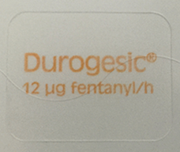
Fentanyl patch example
Brand & Form | DUROGESIC® PATCH | Presentation
Route | Transdermal
Dosing (Adults) Do NOT use fentanyl patch in opioid-naive patients These products are long-acting, and should be changed EVERY 3 DAYS | Base dose on previous 24‑hour opioid requirement in opioid tolerant patient. See product information (PI) for dose*. *Requires conversion of the calculated 24-hour requirement of the previous opioid to the equianalgesic oral morphine dose and then choosing the equianalgesic fentanyl patch dose from the relevant table in the PI. Alternatively, the opioid equianalgesic calculator developed by the FPM ANZCA is also available to use. Frequency of dose: Use 1 patch every 3 days. Dose titration: Adjust dose according to response, see product information for dose titration recommendations.

Slide 20
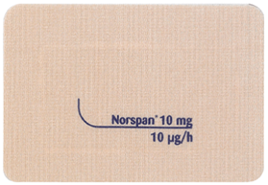
Buprenorphine patch example
Brand & Form | NORSPAN® PATCH | Presentation
Route | Transdermal
Dosing (Adults) These products are long-acting, and should be changed EVERY 7 DAYS | If opioid naïve, the lowest dose, Norspan® patch 5 microgs/hour, should be used as the initial dose. If opioid tolerant, seek specialist advice for starting dose. *Consider the previous opioid history of the patient, including opioid tolerance, if any, as well as current general condition and medical status of the patient. A maximum total dose of buprenorphine 20microgs/hour (or 40 microgs/hour if under specialist advice) should not be exceeded. Frequency of dose: Apply 1 patch every 7 days. Dose titration: Adjust dose according to response, no more frequently than every 3 days if analgesia is insufficient.

Slide 21
Quiz Question 1
In what circumstance is using a fentanyl skin patch appropriate and safe?
For patients who experience acute pain
For opioid-naïve patients with non-cancer pain
For patients who are opioid tolerant and have moderate- severe pain
For opioid-naïve patients with acute pain

Slide 22
Quiz Question 1 - Answer
In what circumstance is using a fentanyl skin patch appropriate and safe?
For patients who experience acute pain
For opioid-naïve patients with non-cancer pain
For patients who are opioid tolerant and have moderate-severe cancer-related pain
For opioid-naïve patients with acute pain
Notes:
Answer:
c. For patients who are opioid tolerant and have moderate- severe pain

Slide 23
Quiz Question 2
Which two statements are correct in terms of frequency of application of each of these patches?
a. Statement 1: Fentanyl patch is to be applied every 3 days
Statement 2: Buprenorphine patch is to be applied every 7 days
b. Statement 1: Fentanyl patch is to be applied every day
Statement 2: Buprenorphine patch is to be applied every 7 days
c. Statement 1: Fentanyl patch is to be applied every 3 days
Statement 2: Buprenorphine patch is to be applied everyday
d. Statement 1: Fentanyl patch is to be applied every 7 days
Statement 2: Buprenorphine patch is to be applied every 3 days

Slide 24
Quiz Question 2 - Answers
Which two statements are correct in terms of frequency of application of each of these patches?
a. Statement 1: Fentanyl patch is to be applied every 3 days
Statement 2: Buprenorphine patch is to be applied every 7 days
b. Statement 1: Fentanyl patch is to be applied every day
Statement 2: Buprenorphine patch is to be applied every 7 days
c. Statement 1: Fentanyl patch is to be applied every 3 days
Statement 2: Buprenorphine patch is to be applied everyday
d. Statement 1: Fentanyl patch is to be applied every 7 days
Statement 2: Buprenorphine patch is to be applied every 3 days
Notes:
a.
Statement 1: Fentanyl patch is to be applied every 3 days
Statement 2: Buprenorphine patch is to be applied every 7 days

Slide 25
Quiz Question 3
Mr. LM, who is in hospital for severe pain, has been prescribed fentanyl patches. This was initiated 3 days ago by Nurse A and today Nurse B has applied the next patch as per the dosing instructions. Mr LM appears excessively confused and sedated.
What are some of the reasons that may have contributed to this?

Slide 26
Quiz Question 3 - Answers
Nurse B not removing the first patch thus resulting in excessive dosing
Patches may have come into contact with a heat source
Other sedating and or opioid medicines have been given (interactions with non-opioid drugs can strongly influence opioid pharmacokinetics.)
Dose of fentanyl patch is too high for Mr. LM
Other explanations may be possible including change in the clinical status of the patient (e.g. hypotension, shock - reduced blood volume increases hypotensive risk and increases the risk of respiratory depression).
Notes:
Answers to be discussed include:
Nurse B not removing the first patch thus resulting in excessive dosing
Patches may have come into contact with a heat source
Other sedating and or opioid medicines have been given (interactions with non-opioid drugs can strongly influence opioid pharmacokinetics.)
Dose of fentanyl patch is too high for Mr LM
Other explanations may be possible including change in the clinical status of the patient (e.g. hypotension, shock - reduced blood volume increases hypotensive risk and increases the risk of respiratory depression)

Slide 27
Quiz Question 4
Mrs KC, a 78 year old female who has swallowing difficulties, was prescribed 15 microgram/hour buprenorphine patches for her pain. The nurse realised there were only 5 microgram/hour and 10 microgram/hour patches left on the wards. What is the most appropriate course of action?
Cut the 10microgram/hour patch in half and apply that with another 10microgram/ hour patch.
Order the 15 microgram/hour patches from the pharmacy department and either pick it up in pharmacy or get it delivered to the ward.
Apply both the 10 microgram/hour patch and the 5 microgram/hour patch simultaneously.
Apply either the 5 microgram/hour patch or the 10 microgram/ hour patch.

Slide 28
Quiz Question 4 - Answer
Mrs KC, a 78 year old female who has swallowing difficulties, was prescribed 15 microgram/hour buprenorphine patches for her pain. The nurse realised there were only 5 microgram/hour and 10 microgram/hour patches left on the wards. What is the most appropriate course of action?
Cut the 10microgram/hour patch in half and apply that with another 10microgram/ hour patch.
Order the 15 microgram/hour patches from the pharmacy department and either pick it up in pharmacy or get it delivered to the ward.
Apply both the 10 microgram/hour patch and the 5 microgram/hour patch simultaneously.
Apply either the 5 microgram/hour patch or the 10 microgram/ hour patch.
Notes:
Answer:
b. Order the 15 microgram/hour patches from the pharmacy department and either pick it up in pharmacy or get it delivered to the ward.

Slide 29
Quiz Question 5.1
Mr. JK has been taking 60 mg of controlled release (CR) morphine ONCE every 24 hours for the last few months for chronic non-cancer pain. He is admitted to the hospital for intractable nausea and vomiting and needs a change in opioid route of administration. He is unable to have parenteral morphine due to previous adverse effects and poor vein access. The team decides that they will switch him to fentanyl patches. What strength of the fentanyl patch should Mr JK be prescribed initially?
12 micrograms/hour
50 micrograms/hour
75 micrograms/hour
100 micrograms/hour

Slide 30
Quiz Question 5.1 - Answer
Answer: a. 12 micrograms/hour
For this scenario, converting from oral morphine to fentanyl patch, it is recommended that clinicians consult the product information (PI) for dose conversion tables.
Note that the PI recommends different dosing recommendations for cancer vs non-cancer pain patients.
Clinicians must not use these dose conversion tables to convert in the other direction, i.e. from fentanyl patch to other opioid therapies because the product information conversion from oral morphine to fentanyl patch is conservative. Use of the table conversion to other analgesic therapies can overestimate the dose of the new agent and may lead to overdosage of the new analgesic agent.
The answer can also be obtained by using an opioid equianalgesic calculator developed by the Faculty of Pain Medicine, Australian and New Zealand College of Anaesthetists (FPM ANZCA).
All opioid dose conversions whether from the PI or a calculator app are approximate.
Patients should be monitored closely so that the dose can be adjusted if necessary and breakthrough pain relief should be available and offered as needed.
Final calculated doses may have to be rounded up or down to fit in with the preparations available.
Notes:
Answer: a. 12 micrograms/hour
Notes: Patches are available as: 12 mcg/hour, 25 mcg/hour, 50 mcg/hour, 75 mcg/hour, 100 mcg/hour
Info:
For this scenario, converting from oral morphine to fentanyl patch, it is recommended that clinicians consult the product information (PI) for dose conversion tables.
Note that the PI recommends different dosing recommendations for cancer vs non-cancer pain patients.
Clinicians must not use these dose conversion tables to convert in the other direction, i.e. from fentanyl patch to other opioid therapies because the product information conversion from oral morphine to fentanyl patch is conservative. Use of the table conversion to other analgesic therapies can overestimate the dose of the new agent and may lead to overdosage of the new analgesic agent.
For this scenario, the answer can also be obtained by using an opioid equianalgesic calculator developed by the Faculty of Pain Medicine, Australian and New Zealand College of Anaesthetists (FPM ANZCA).
All opioid dose conversions whether from the PI or a calculator app are approximate.
Patients should be monitored closely so that the dose can be adjusted if necessary and breakthrough pain relief offered as needed.
Final calculated doses may have to be rounded up or down to fit in with the preparations available.

Slide 31
Quiz Question 5.2
Mr JK’s last dose of CR morphine was at 8am. It is now 5pm. When should the fentanyl patch be applied?
As soon as possible, at 5pm
At 8am the next day
At 8pm
At dinner time

Slide 32
Quiz Question 5.2 - Answer
Mr JK’s last dose of CR morphine was at 8am. It is now 5pm. When should the fentanyl patch be applied?
As soon as possible, at 5pm
At 8am the next day
At 8pm - When switching from an oral opioid, apply the first fentanyl patch 12 hours after the last dose of a 24‑hour controlled release product (AMH)
At dinner time
Notes:
Answer:
c. At 8pm
Info:
When switching from an oral opioid, apply the first fentanyl patch (AMH):
- at the same time as the last dose of a 12‑hour controlled release product OR
- 12 hours after the last dose of a 24‑hour controlled release product
AMH: patch takes about 24–72 hours to reach maximum effect; steady-state concentration may not be reached until the second patch is applied; wean other analgesics slowly after first patch is applied
PI (TGA): After initial DUROGESIC application, serum fentanyl concentrations increase gradually, generally levelling off between 12 and 24 hours and remaining relatively constant for the remainder of the 72- hour application period.
PI (MIMs): Peak serum concentrations of fentanyl generally occur between 24 and 72 hours after the first application.

Slide 33
Better understand opioids in practice
The following resources may provide you with useful scenarios/cases and recommended approaches
NSW TAG Practical guidance: Preventing and managing problems with opioid prescribing for chronic non-cancer pain (July 2015)
American Society of Health-System Pharmacists, Demystifying opioid conversion calculations: Transdermal and Parenteral Fentanyl Dosage Calculations and Conversions

Slide 34
References
NPS Radar. Fentanyl patches for chronic pain. 1 August 2006. https://www.nps.org.au/radar/articles/fentanyl-patches-durogesic-for-chronic-pain Accessed 30/05/2019
eTG complete Palliative Care. Pain: opioid therapy in palliative care. Accessed on 30/05/2019 via CIAP
Australian Medicines Handbook online, 2019. Accessed on 30/05/2019 via CIAP
Royal College of Anaesthetists. Dose equivalent and changing opioids. https://www.rcoa.ac.uk/faculty-of-pain-medicine/opioids-aware/structured-approach-to-prescribing/dose-equivalents-and-changing-opioids Accessed 30/05/2019
eviQ Opioid Conversion Calculator. https://www.eviq.org.au/clinical-resources/eviq-calculators/3201-opioid-conversion-calculator Accessed 30/05/2019
FDA Drug Safety Communications. FDA requiring color changes to Duragesic (fentanyl) pain patches to aid
safety―emphasizing that accidental exposure to used patches can cause Death. 23 September 2013. http://wayback.archive-it.org/7993/20170113080921/http://www.fda.gov/downloads/Drugs/DrugSafety/UCM368911.pdf Accessed 30/05/2019
Health Quality & Safety Commission New Zealand. ALERT: Transdermal patches. 26 September 2019. https://www.hqsc.govt.nz/our-programmes/medication-safety/publications-and-resources/publication/1303/ Accessed on 03/10/2019
Australian and New Zealand College of Anaesthetists. Statement on the Use of Slow-Release Opioid Preparations in the Treatment of Acute Pain. March 2018. http://www.anzca.edu.au/resources/endorsed-guidelines/position-statement-on-the-use-of-slow-release-opio Accessed 18/02/2020
Faculty of Pain Medicine, Australian and New Zealand College of Anaesthetists. Opioid Calculator. 2019. http://www.opioidcalculator.com.au/
Durogesic Australian Product Information, 20 December 2019. https://www.ebs.tga.gov.au/ebs/picmi/picmirepository.nsf/pdf?OpenAgent&id=CP-2010-PI-01511-3&d=202002161016933 Accessed 17/02/2020
Therapeutic Goods Administration. Safety information, Prescription opioids hub: Upcoming changes to reduce harm. 4 February 2020 https://www.tga.gov.au/alert/prescription-opioids-hub Accessed 17/02/2020
NSW Therapeutic Advisiry Group Inc. Preventing and managing problems with opioid prescribing for chronic non-cancer pain. July 2015. http://www.nswtag.org.au/wp-content/uploads/2017/07/pain-guidance-july-2015.pdf Accessed 18/02/2020
American Society of Health-System Pharmacists. Demystifying opioid conversion calculations: Transdermal and Parenteral Fentanyl Dosage Calculations and Conversions. https://www.ashp.org/-/media/store-files/p1985-sample-chapter-5.ashx Accessed 18/02/2020

Slide 35
Contact details:
<< Health service name >>
Ph: << 0000 0000 pager XXXX >>
Email: <<add email address>>

